Slide 1
HealthApp
Team 4:
Tarun Dagar
Jigarkumar Patel
Riddhi Mhatre
Vivek Karhale
Sriharsha Mopidevi
Fernando Hernández
Aliaksandra Paliashchuk
Nishith Desai

Slide 2
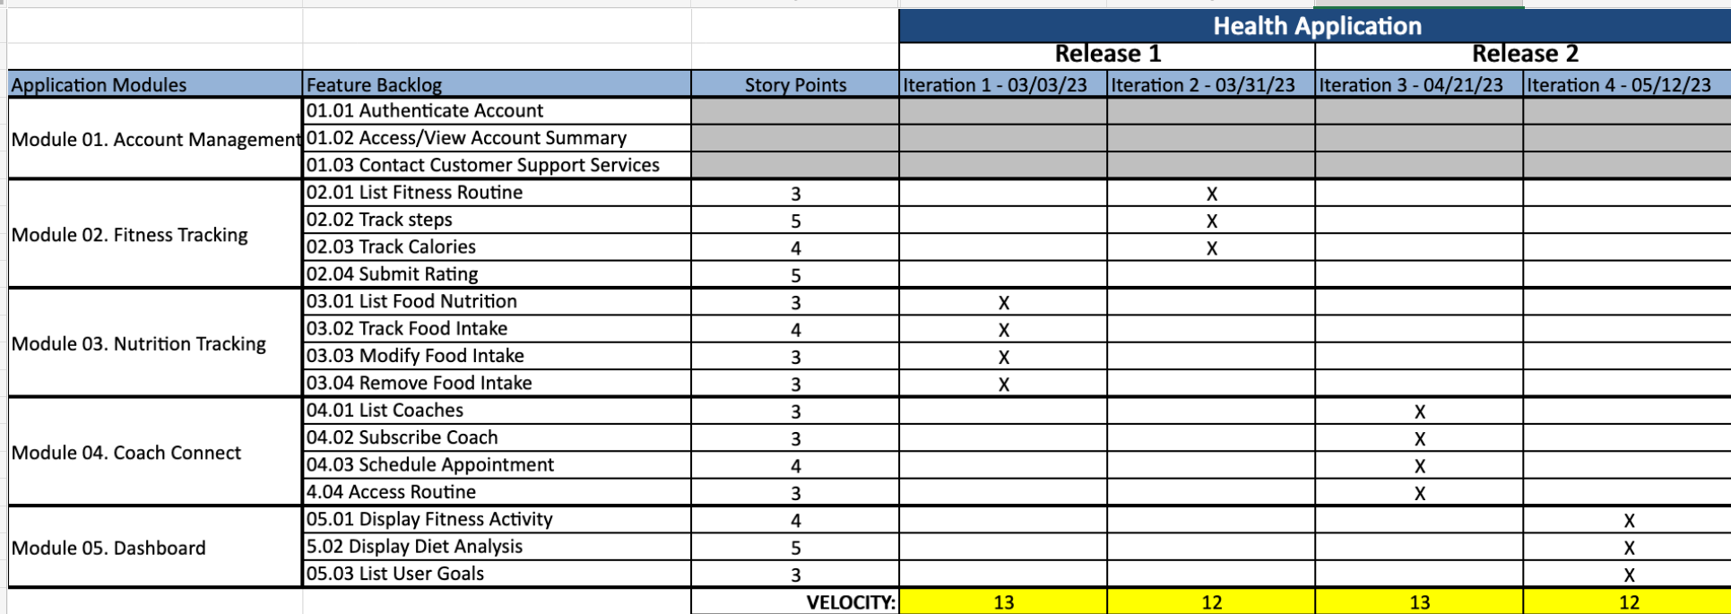
Roadmap - Riddhi

Slide 3
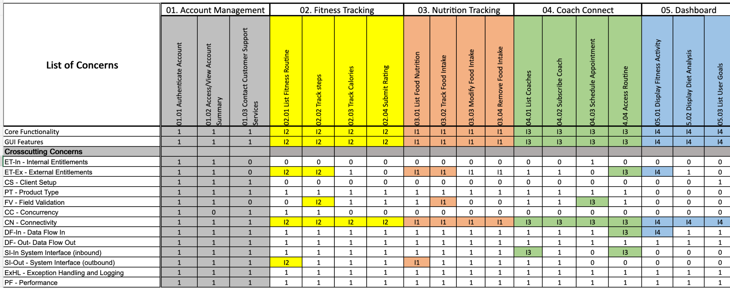
RCT I3 – Aliaksandra

Slide 4
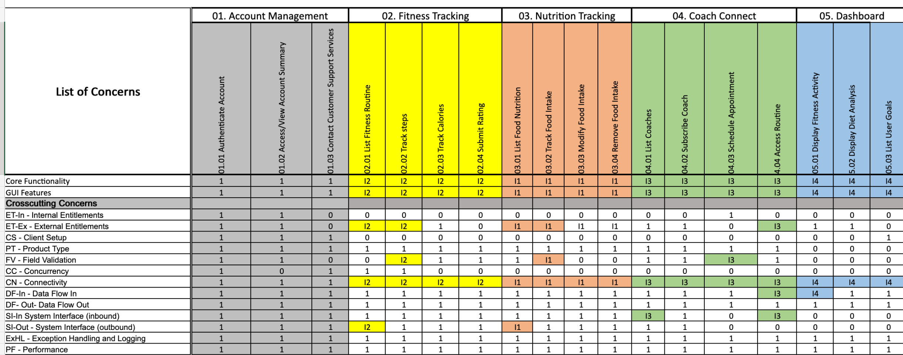
RCT I4 – Aliaksandra

Slide 5
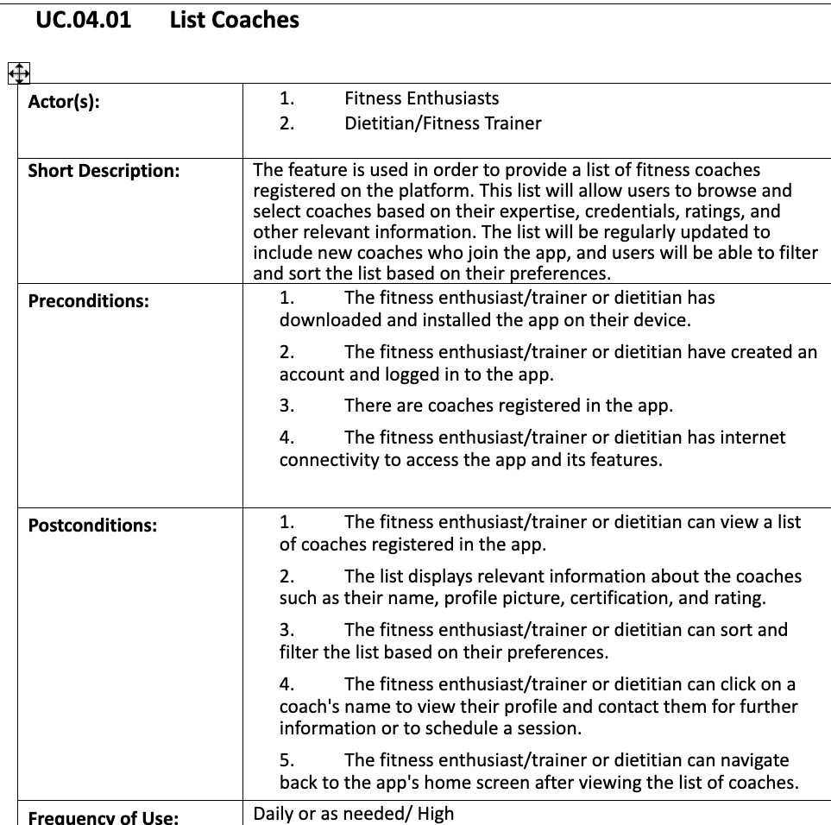
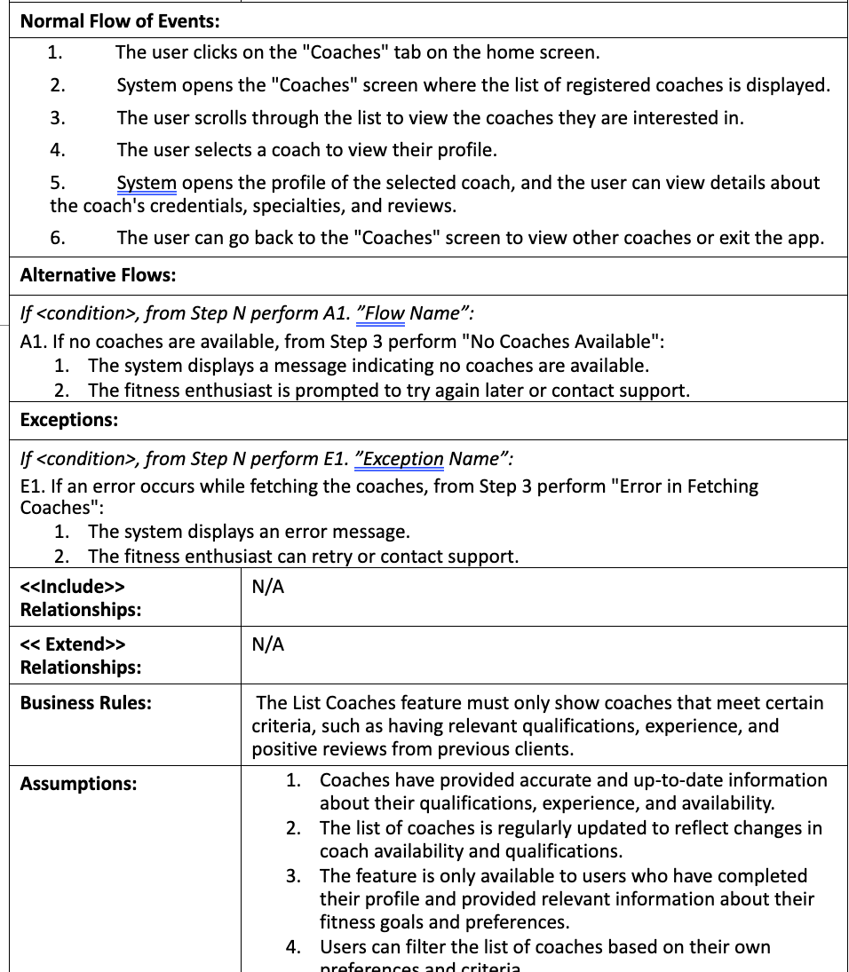
Use Case Specification – Vivek

Slide 6
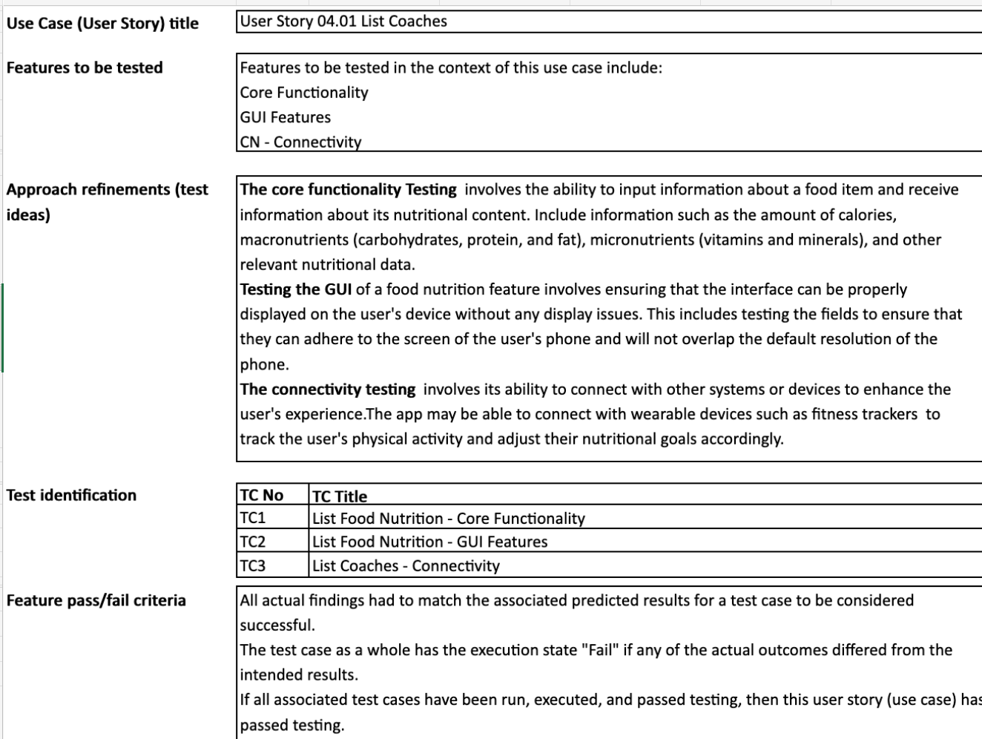
Functional Test – Nishith

Slide 7
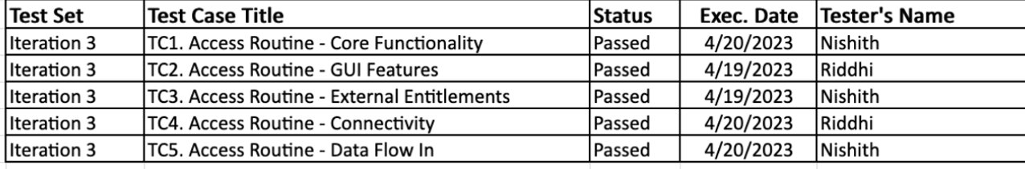
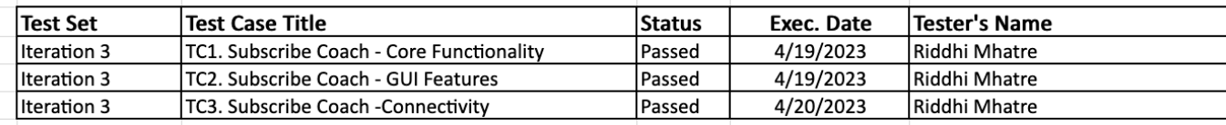
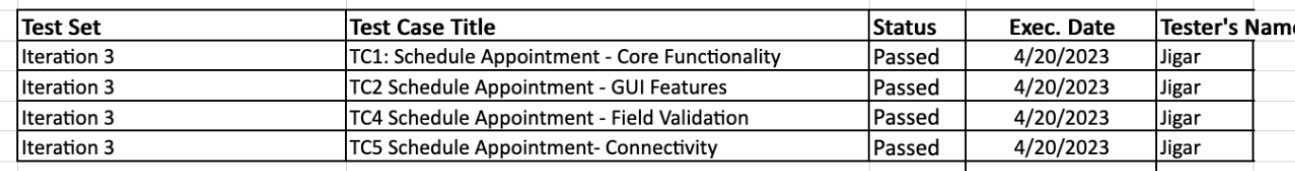
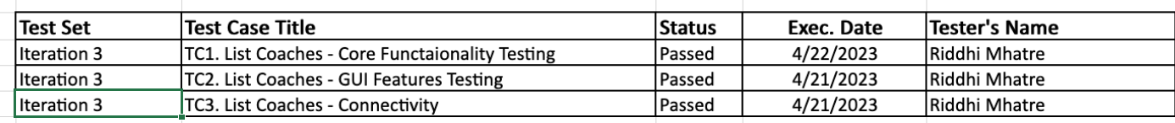
Test Execution Log I3 – Jigar

Slide 8
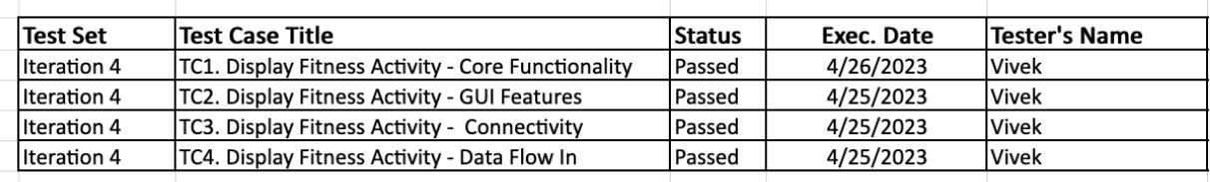
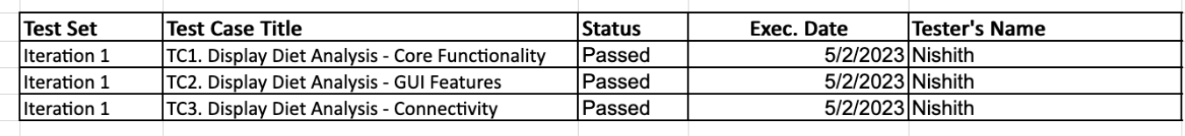
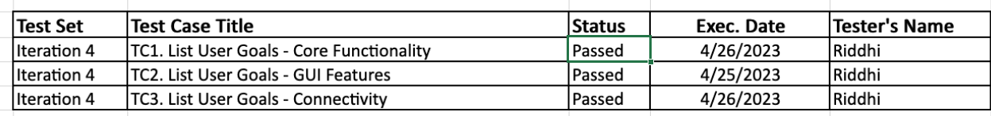
Test Execution Log I4 – Jigar

Slide 9
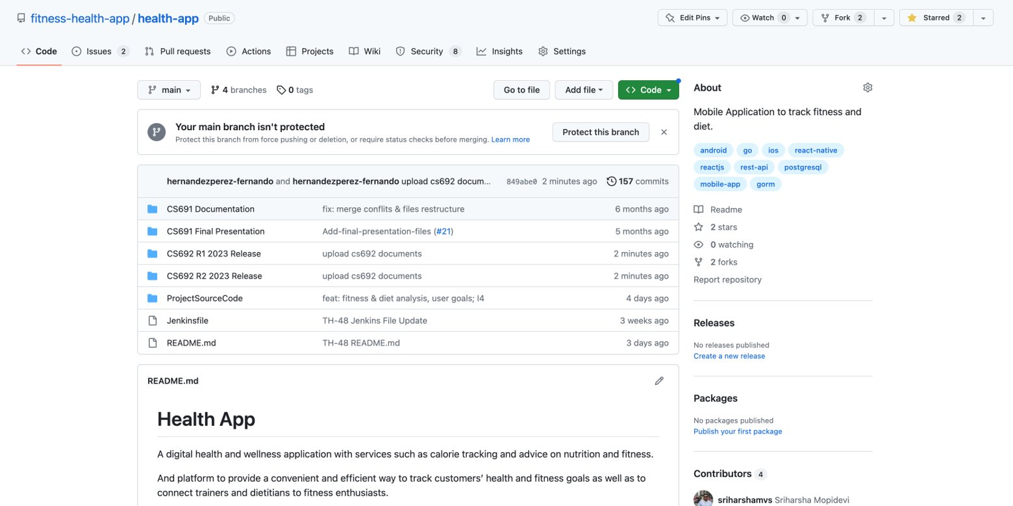
Git (r2 documents) – Fernando

Slide 10
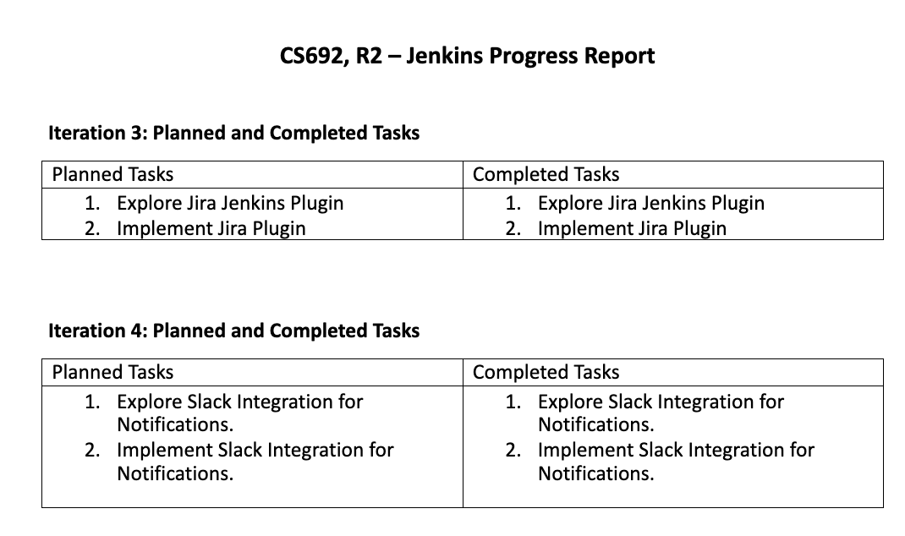
Jenkins Progress Report – Tarun

Slide 11
Application Demo – Sriharsha

